Slide 1
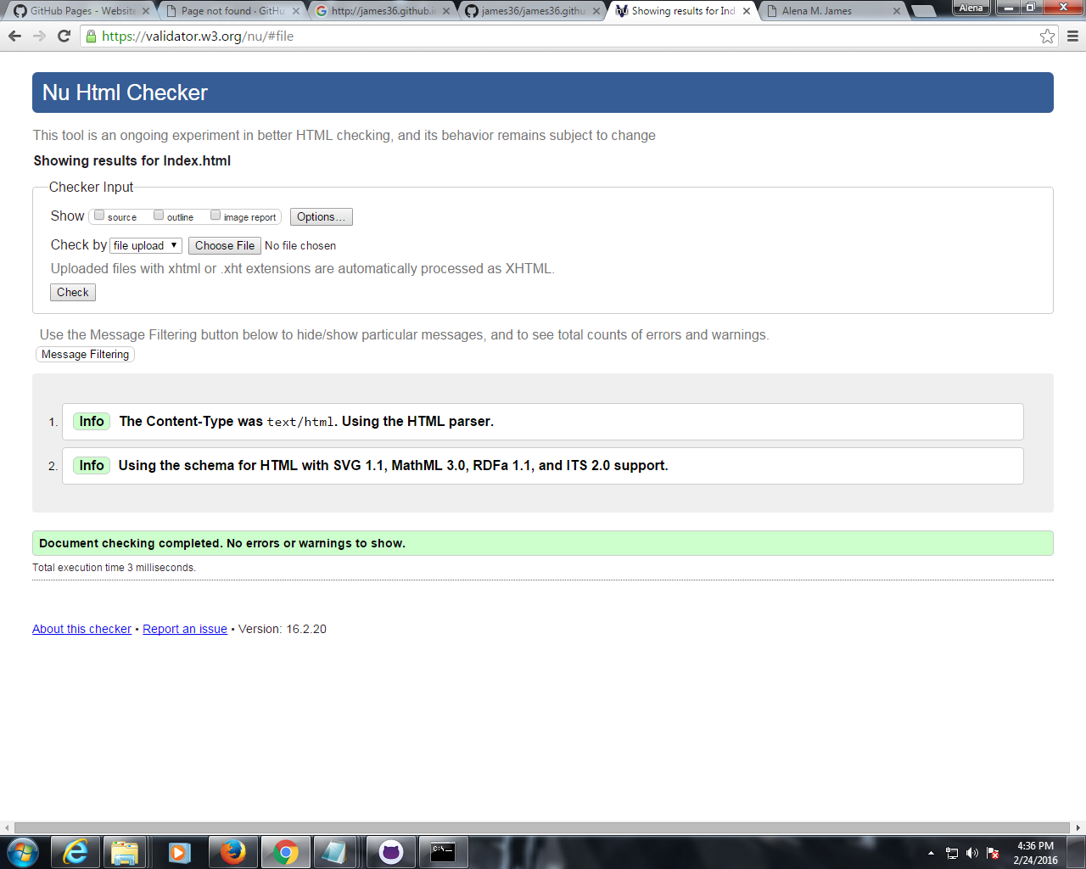

Slide 2
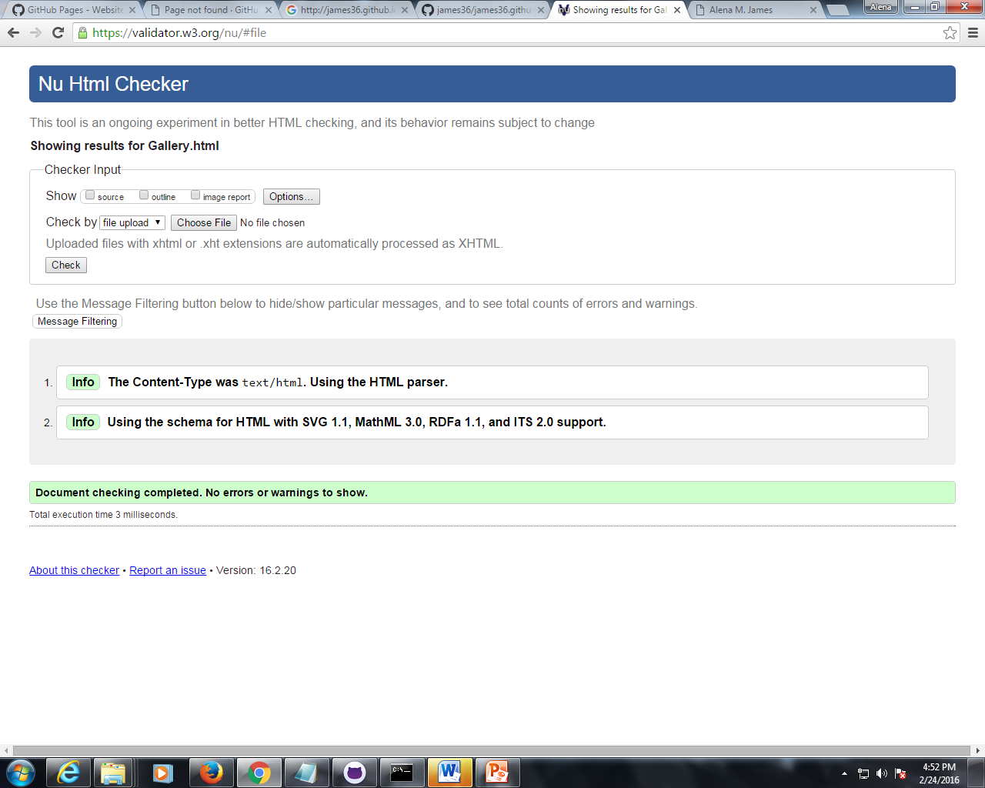

Slide 3
Wire Frame Index Page
Header
Main
Img
img
Nav
Footer

Slide 4
Wire Frame Gallery Page
Header
Img
Img
Img
img
title
title
title
title
Footer

